Slide 1
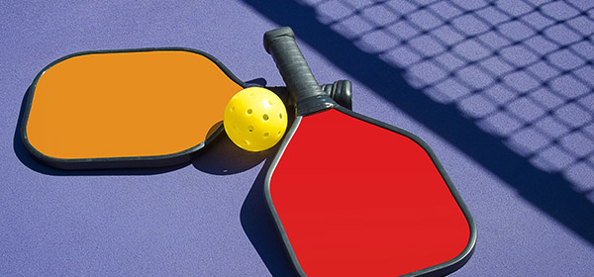
Pickleball

Slide 2
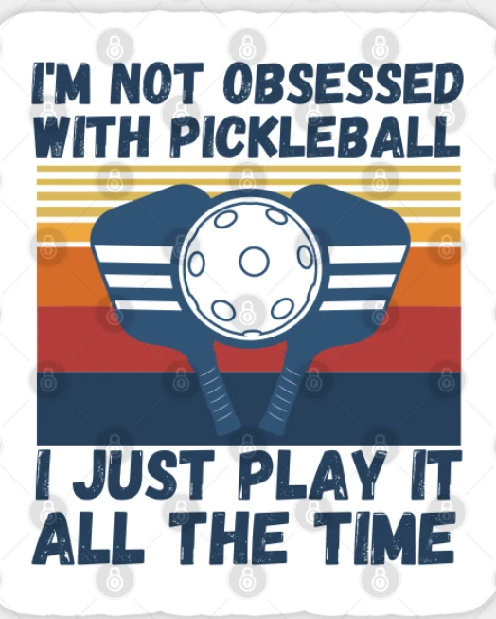
Pickleball, is it an obsession?
https://www.youtube.com/shorts/dA81lyxs2YQ

Slide 3
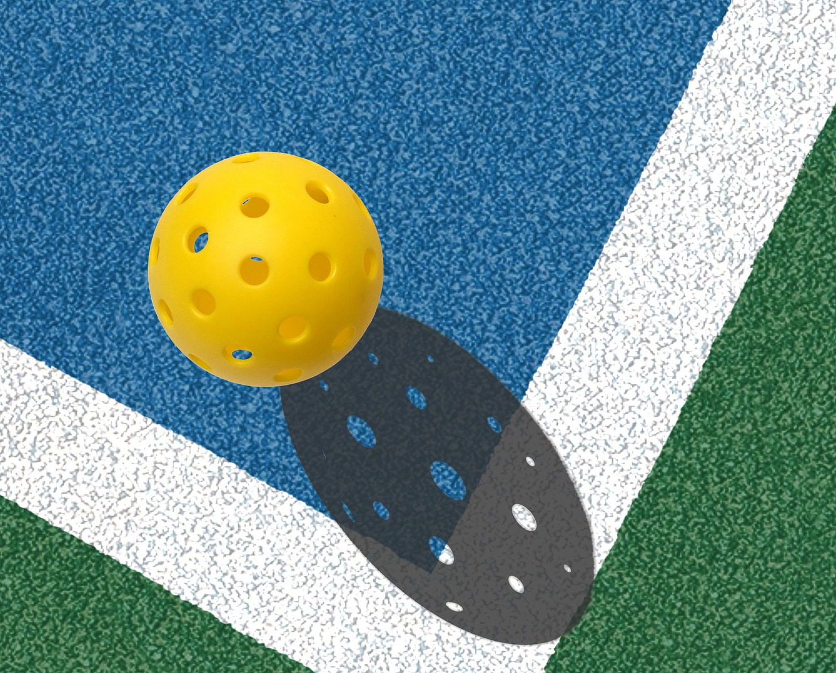
History of Pickleball
Started in 1965 in Bainbridge Island in Washington State by three friends over a weekend.
Pickleball is the combination of tennis (net), ping-pong (paddle), badminton (size of the court), and is played with a whiffle ball.
The name comes from a term from used in crewing, “pickle”, “where oarsmen were chosen from the leftovers of other boats”, the wife of one of the friends picked the name because it was a combination of “leftovers” from the three sports (USA Pickleball Association, Littlewood, Mary, Pickleball Fundamentals, 2015).
The rules were developed over the weekend as the group of friends played.

Slide 4
Stats of Pickleball
In 2021, Pickleball grew to 4.8 million players in the US (2022 Sports & Fitness Industry Association Single Sport Report on Pickleball), a growth of 14.8% from 2020 to 2021.
3.5 million are “Casual” Pickleball players who play 1-7 times a year.
1.4 million are “Core” Pickleball players who play 8 or more times a year.
From 2020 to 2021, Pickleball was the fastest growing sport among players under the age 24 at 21%.
The average age of a pickleballer for “Core” is 47.9 years and for “Casual” is 34.3 years.
All statistics were found at: https://usapickleball.org/about-us/organizational-docs/pickleball-fact-sheet/

Slide 5
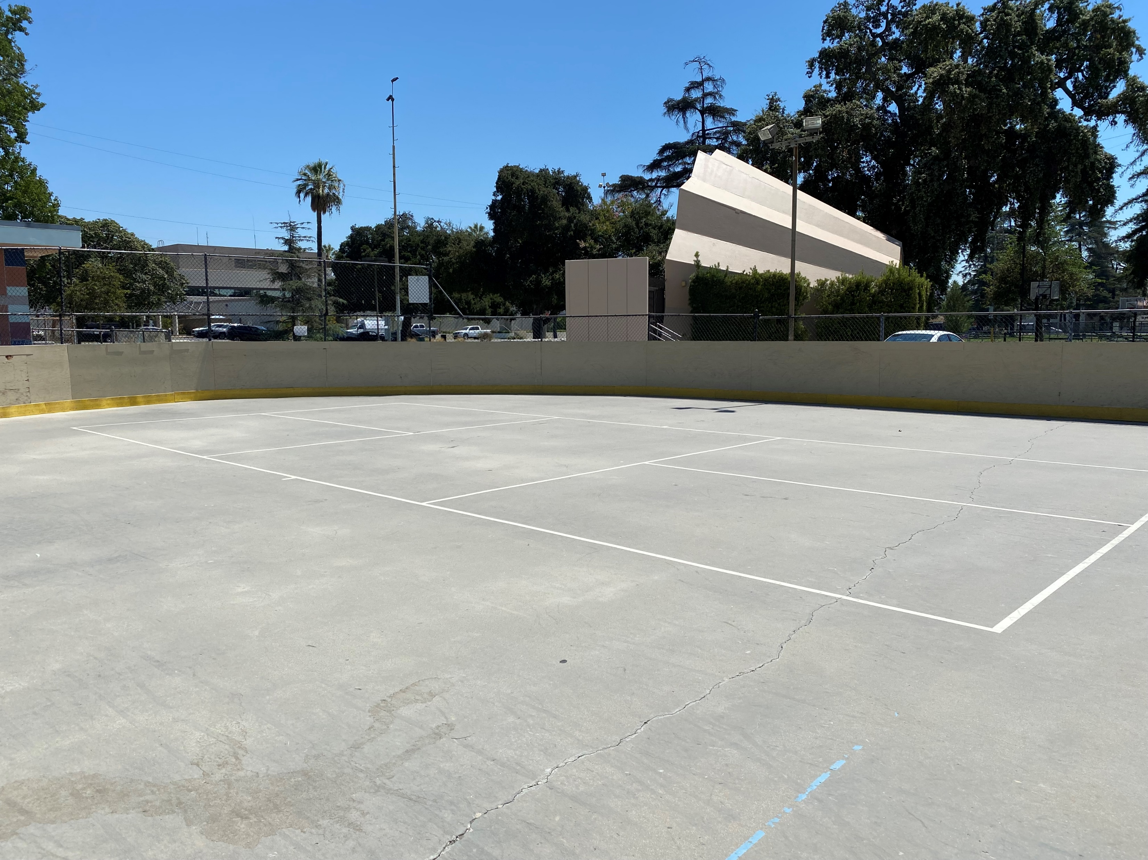
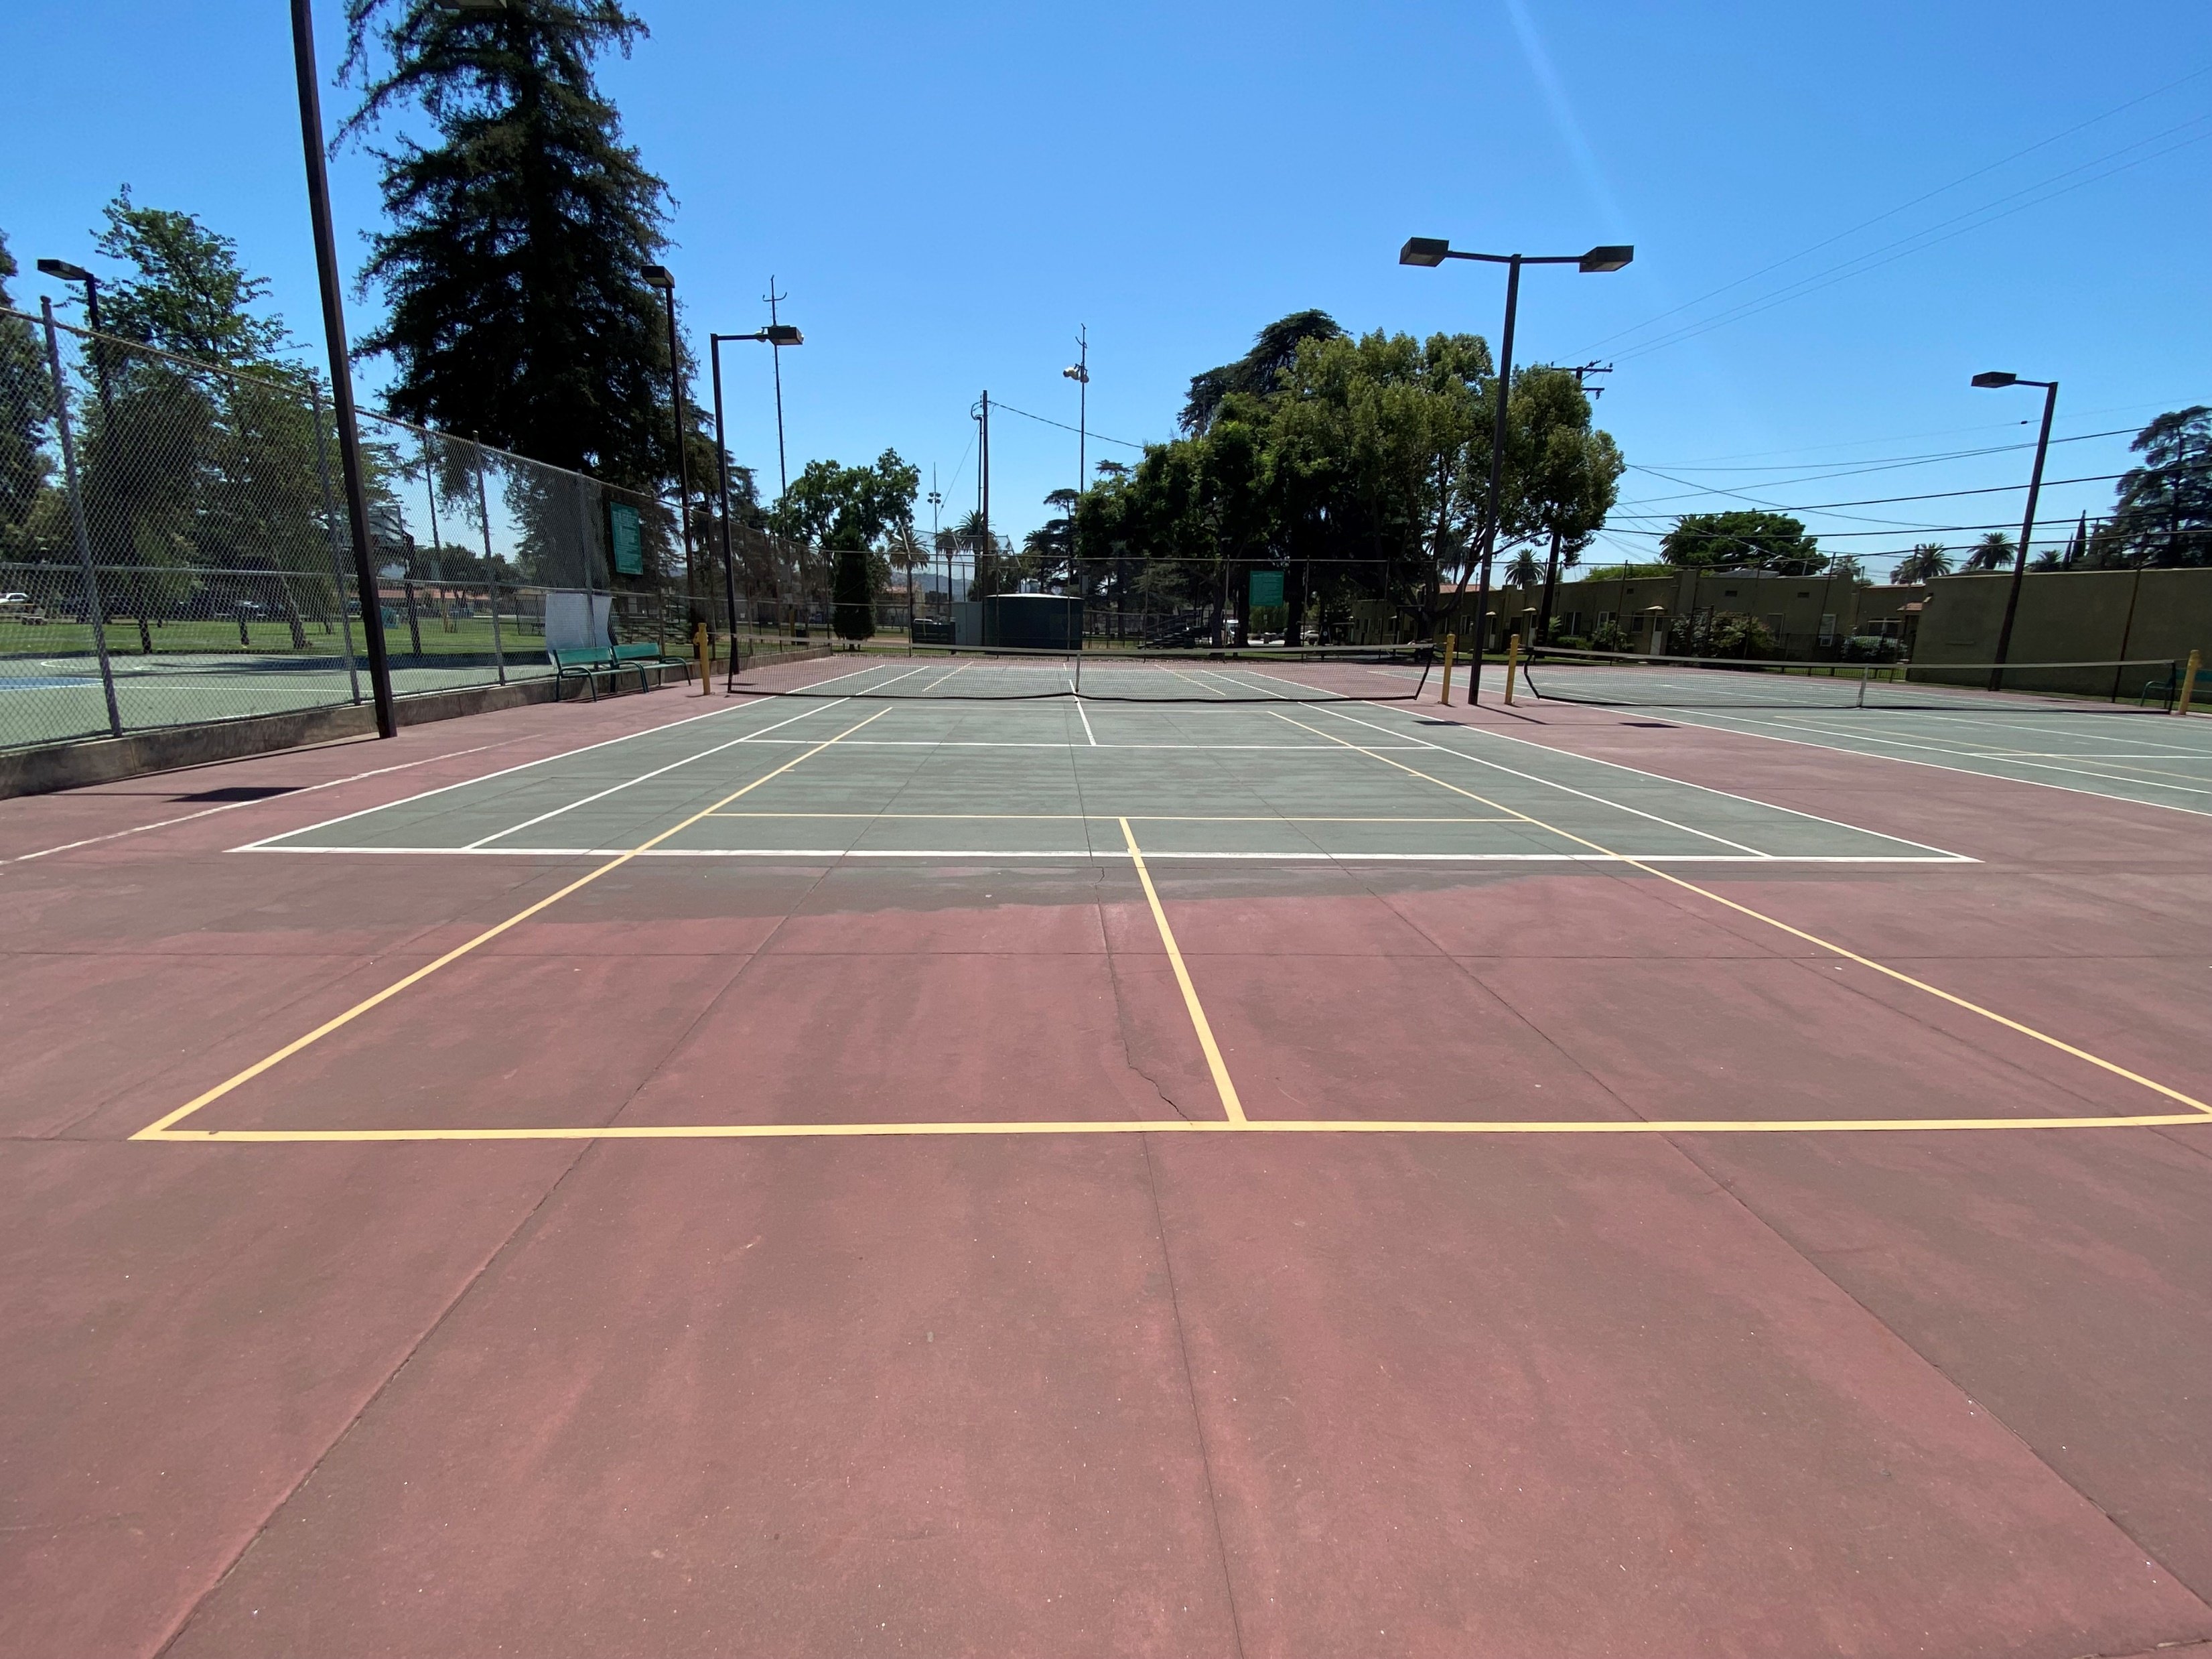
Courts: where can they go?
Hockey rinks
Tennis courts

Slide 6
Rules
Serving Sequence
Both players on the serving doubles team have the opportunity to serve and score points until they commit a fault *(except for the first service sequence of each new game).
The first serve of each side-out is made from the right/even court.
If a point is scored, the server switches sides and the server initiate the next serve from the left/odd court.
When the first server loses the serve the partner then serves from their correct side of the court (except for the first service sequence of the game*).
The second server continues serving until his team commits a fault and loses the serve to the opposing team.
Once the service goes to the opposition (at side out), the first serve is from the right/even court and both players on that team have the opportunity to serve and score points until their team commits two faults.
Scoring
Points are scored only by the serving team.
Games are normally played to 11 points, win by 2.
Two-Bounce Rule
When the ball is served, the receiving team must let it bounce before returning, and then the serving team must let it bounce before returning, thus two bounces.
After the ball has bounced once in each team’s court, both teams may either volley the ball (hit the ball before it bounces) or play it off a bounce (ground stroke).
The two-bounce rule eliminates the serve and volley advantage and extends rallies.
Non-Volley Zone
Volleying is prohibited within the non-volley zone. This rule prevents players from executing smashes from a position within the zone.
It is a fault if, when volleying a ball, the player steps on the non-volley zone, including the line and/or when the player’s momentum causes them or anything they are wearing or carrying to touch the non-volley zone including the associated lines.
It is a fault if, after volleying, a player is carried by momentum into or touches the non-volley zone, even if the volleyed ball is declared dead before this happens.
A player may legally be in the non-volley zone any time other than when volleying a ball.
The non-volley zone is commonly referred to as “the kitchen.”

Slide 7
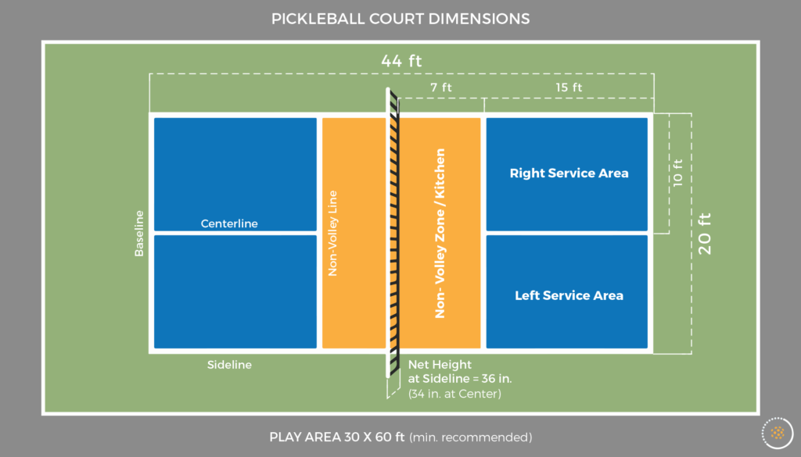
Court lay out

Slide 8
First Video
55+ class is working on the “Dink” shot
Dink shot is performed from inside the non-valley zone, is hit after the ball bounces with the intent on having the ball skim over the top of the net and land in the opposing non-volleying zone closes to the net.

Slide 10
Second Video
Is a rally in our Open Play Pickleball

Slide 12
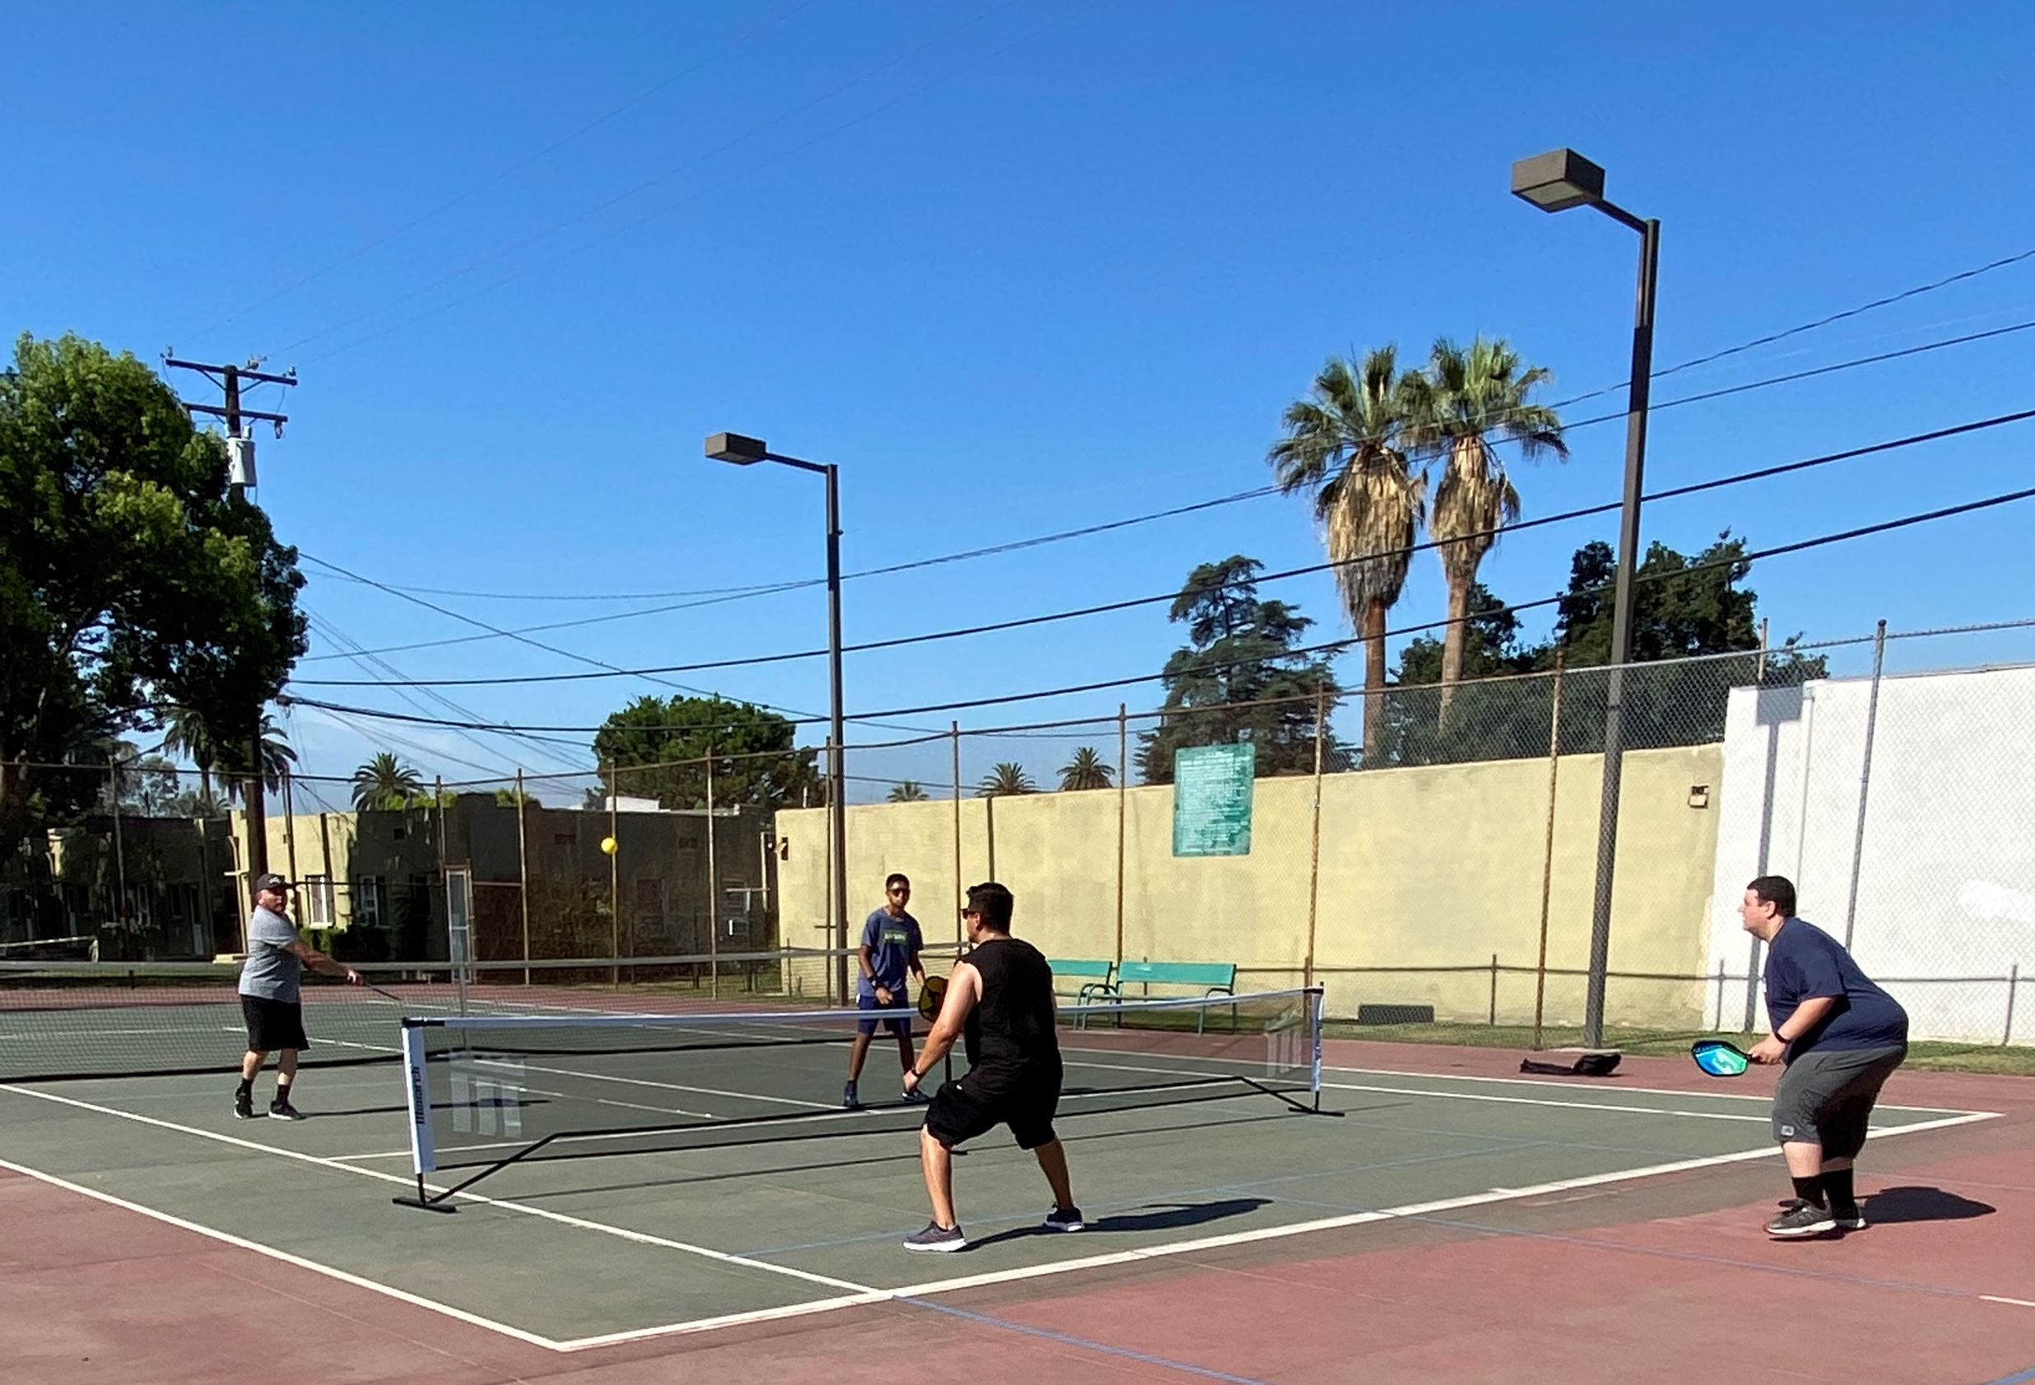
Structure of Programs
Class structure
4-weeks sessions.
First 2 weeks are focusing on drills, learning the rules, and game play.
Last 2 weeks only games are play.
Same structure for both 55+ and 13+ and up class, however class structure can change base on the skill levels.
Classes run for 1 hour.
Fees: For 55+ is $20 and 13+ is $40, we charge enough to cover cost of 1 staff member and small amount for replacement equipment
Open play structure
Monthly registration for three days a week for 7 total hours of play time.
Monday, 5-7:30 pm, Wednesday, 8-10 am, and Saturday, 8-10:30 am
Staff put up nets, check in participants, and monitor the courts.
Participants rotate in when a courts is open.
30 per month with 12 average in attendance each day-Saturday is the busiest day with up to 30 in attendance.
Side note: we have paddles for use during the classes and open play, however many of the participants have their own Pickleball paddles.

Slide 13
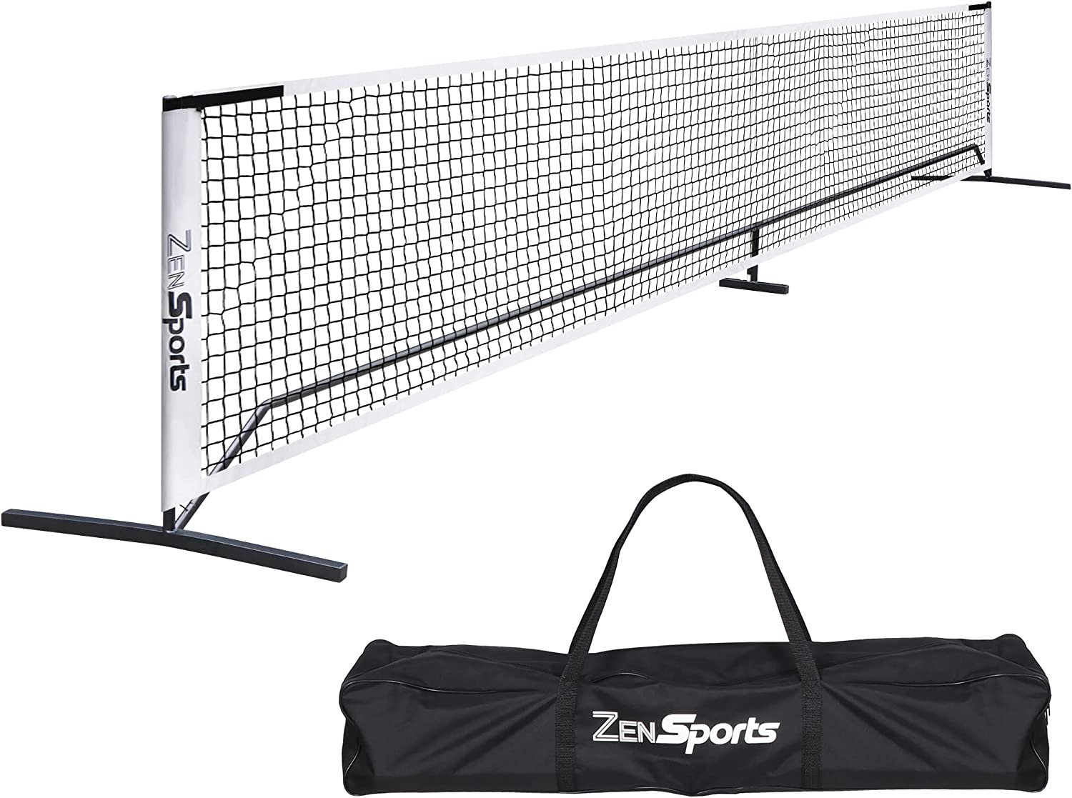
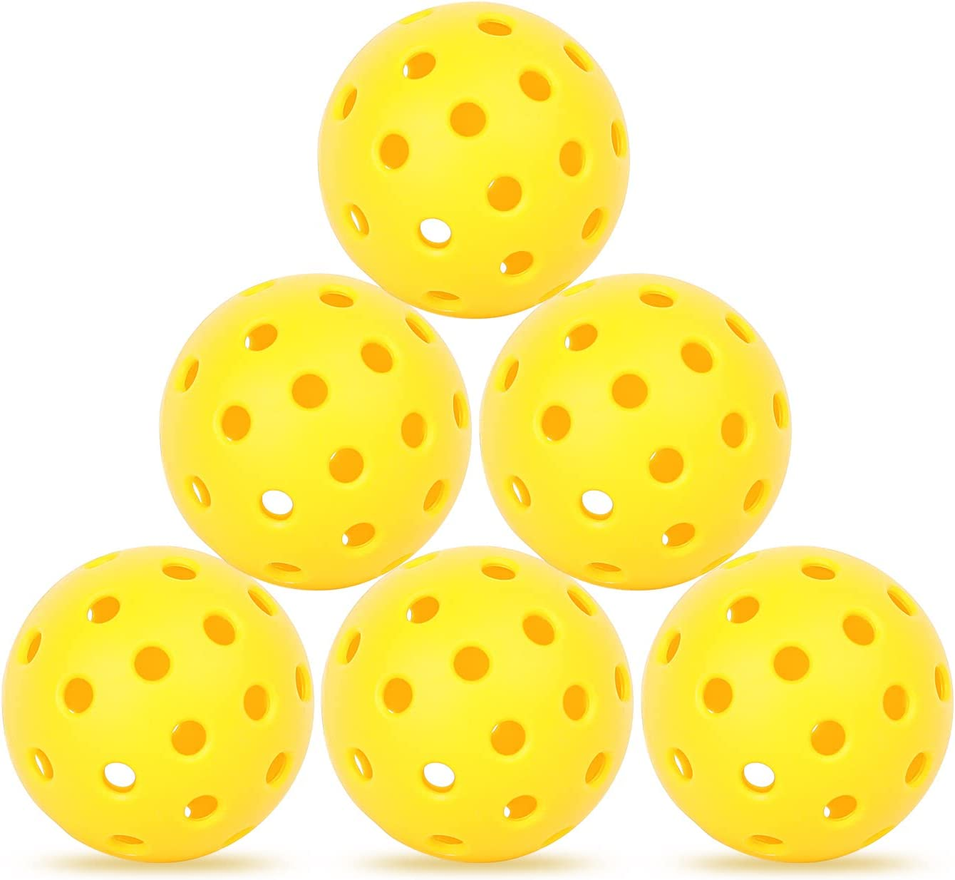
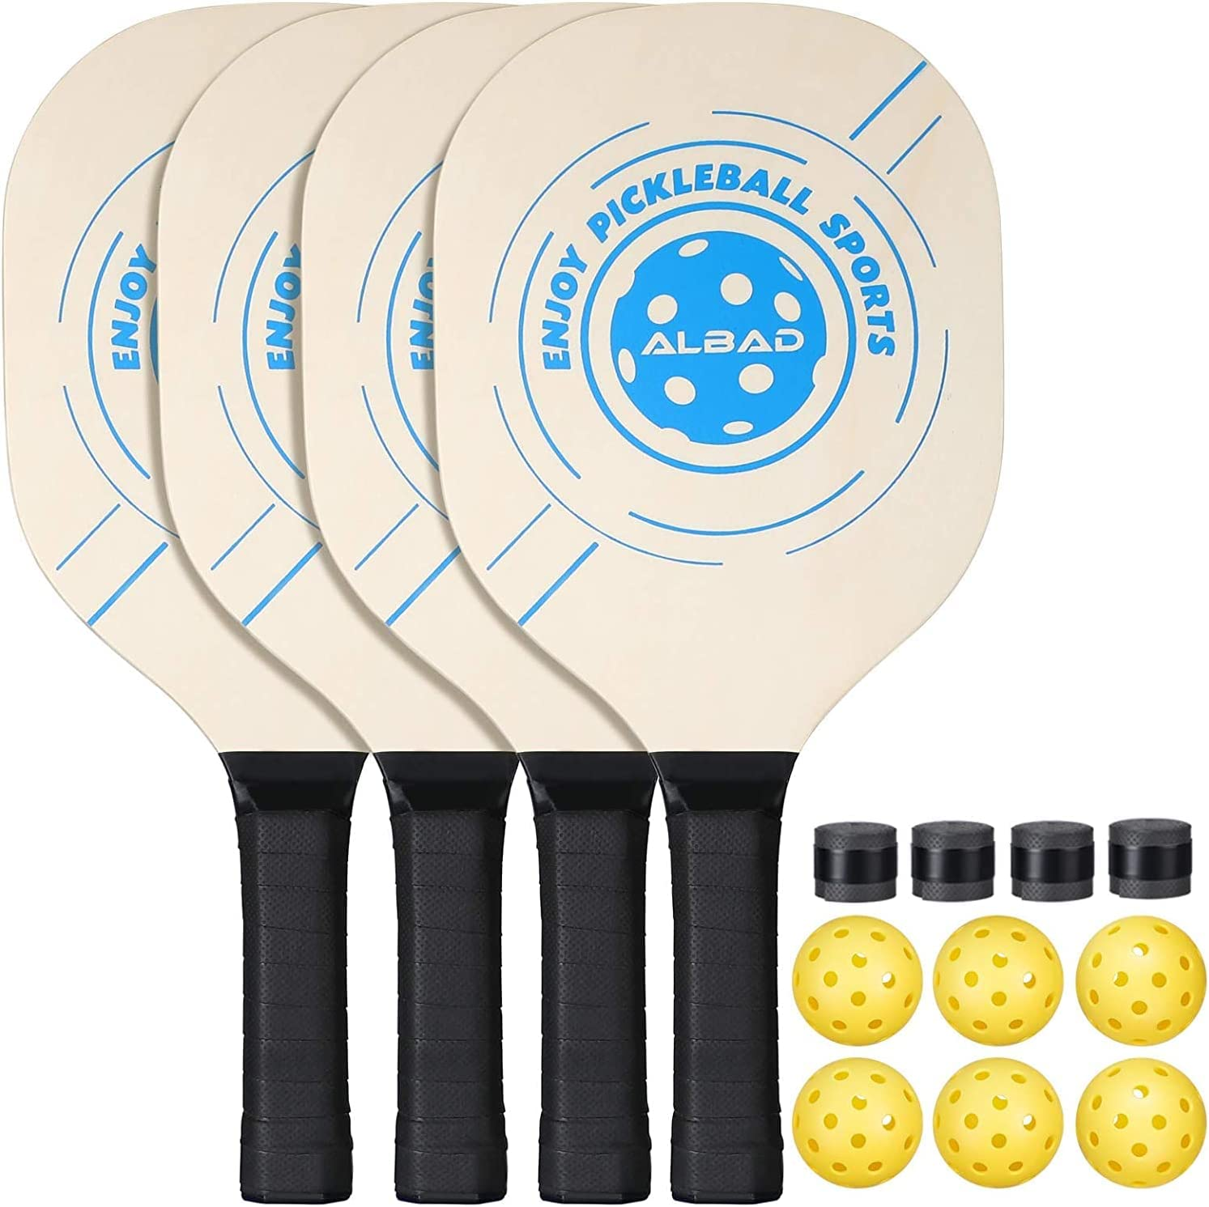
Getting Started
Nets from Amazon.com: https://www.amazon.com/gp/product/B083S63BRF/ref=ox_sc_saved_title_1?smid=A10PRH2DFOVNA8&psc=1
Balls from Amazon.com: https://www.amazon.com/Pickleball-Outdoor-Pickleballs-Elasticity-Accessories/dp/B09ZQL7RDR/ref=sr_1_2_sspa?crid=1IFIVS5WDBDJL&keywords=pickleball%2Bballs&qid=1661979156&s=sporting-goods&sprefix=pickleball%2Csporting%2C142&sr=1-2-spons&th=1
Paddles from Amazon.com: https://www.amazon.com/Pickleball-Durable-Professional-Lightweight-carrying/dp/B087P3DJ71/ref=sr_1_18?crid=LBXIDZHPY645&keywords=pickleball+paddle+set+of+4&qid=1661979925&s=sporting-goods&sprefix=pickleball+paddle+%2Csporting%2C136&sr=1-18

Slide 14
Additional Information
https://usapickleball.org/
https://www.pickleballcentral.com/

